Slide 1

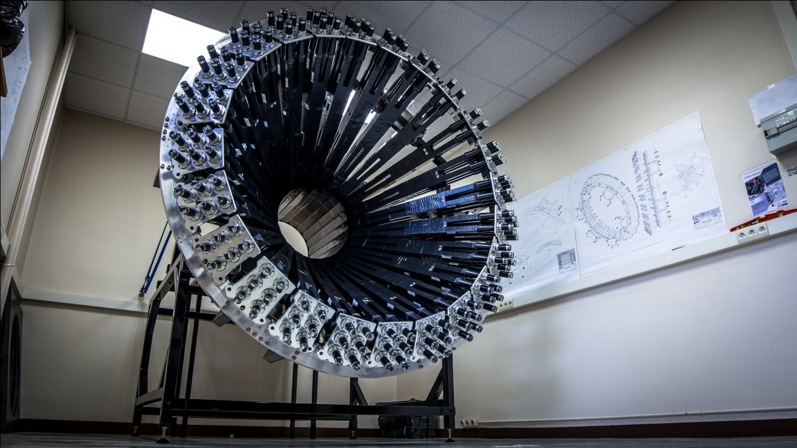
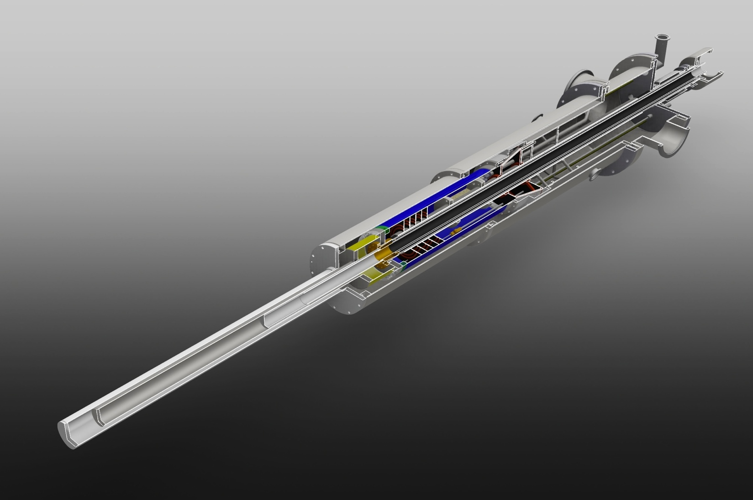
C12-15-004: DVCS, DIS, and SIDIS with a longitudinally polarized deuterium target
Silvia Niccolai
PAC44, JLab, 7/26/2016

Slide 2















C12-15-004: DVCS, DIS, and SIDIS with a longitudinally polarized deuterium target
Co-spokespersons:
A. Biselli (Fairfield U),
C. Keith (JLab),
S. Kuhn (ODU)
S. Niccolai (IPN Orsay),
S. Pisano (INFN Frascati),
D. Sokhan (Glasgow U)
Silvia Niccolai
PAC44, JLab, 7/26/2016
Saclay
A CLAS collaboration proposal
Notes:
Point to the spokespersons, mention that there are institutions that signed, and say that the CLAS Collaboration endorsed the proposal after an internal review

Slide 3
C12-15-004: DVCS, DIS, and SIDIS with a longitudinally polarized deuterium target
Silvia Niccolai
PAC44, JLab, 7/26/2016
Outline:
Multi-dimensional mapping of the nucleon
Flavor separation of parton distributions
Polarized target experiments with CLAS12
Run group M: beam time request
Experimental setup
Physics cases:
Polarized nDVCS
DIS
SIDIS
Additional topics

Slide 4
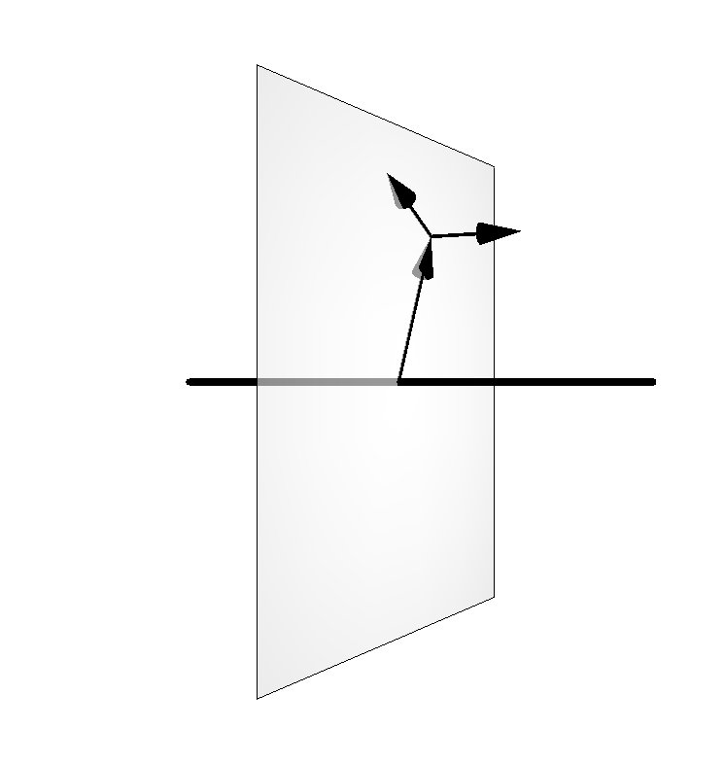
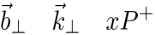
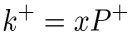

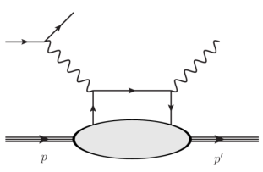
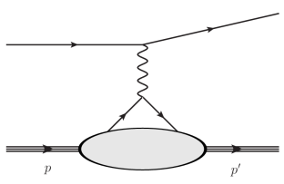
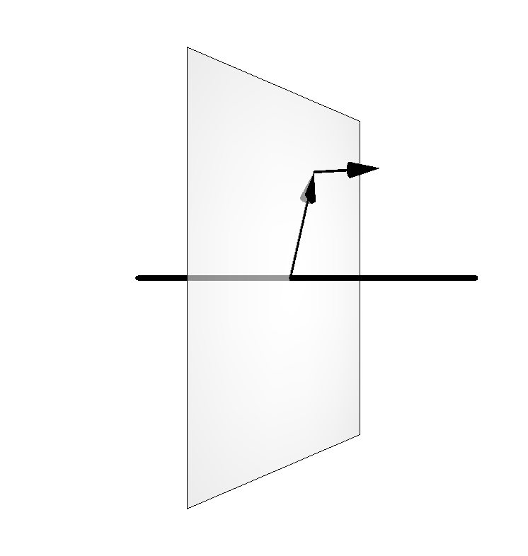
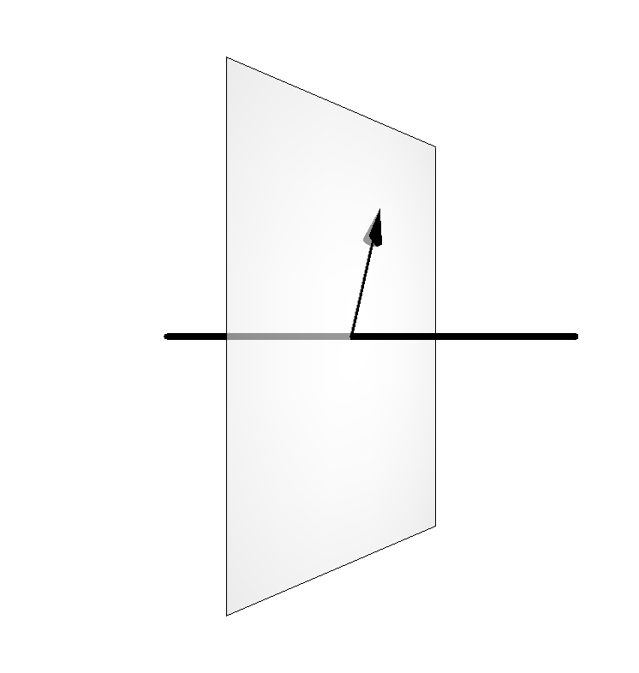
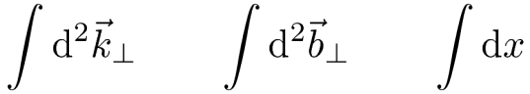
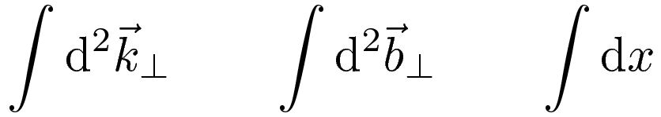

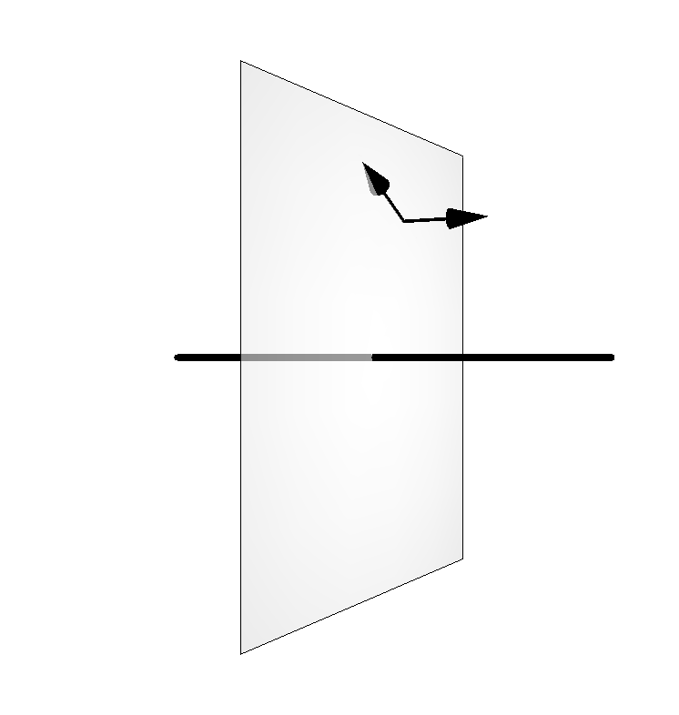
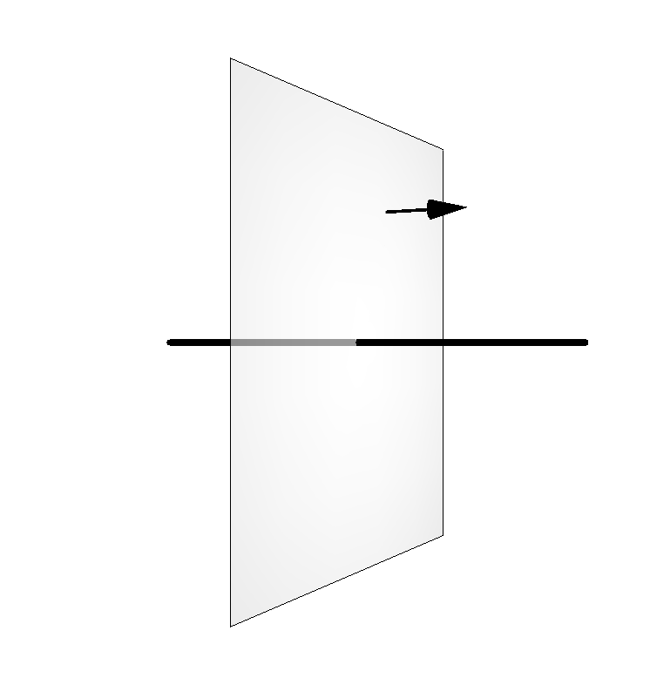
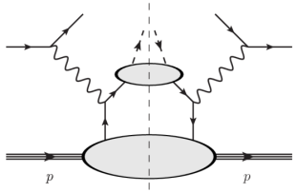
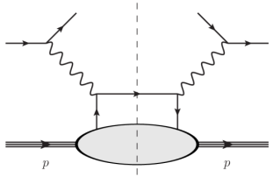
Longitudinal momentum
Multi-dimensional mapping of the nucleon
Transverse momentum
Impact parameter
DVCS
Elastic Scattering
GPDs
FFs
GTMDs
TMDs
PDFs
SIDIS
DIS

Slide 5
Flavor decomposition of parton distributions
Proton and neutron have different flavor compositions → observables on these two target types are linked to different mixtures of quark structure functions
Experiments on proton and deuterium targets must be performed to disentangle the flavor dependence of the various kinds of parton distributions
Longitudinally polarized observables: nuclear targets, such as NH₃ and ND₃ are used
ND₃ typically has ½ the polarization of NH₃
Virtual-photon asymmetry from DIS
SIDIS pion asymmetry
Compton form factors
from DVCS

Slide 6
ND₃ experiments with CLAS12: history
E12-06-109 (Polarized DIS): 30 days on NH₃ (+overhead), 50 days on ND₃ (+overhead) (run group Cb)
E12-06-119b (DVCS on longitudinally polarized protons): 120 days on NH₃ (run group C)
E12-07-107 (SIDIS with long. pol. target), E12-09-007b, E12-09-009 (K-SIDIS with long. pol. target)
→ ~2.5 more beam time for NH₃ than ND₃
PR12-15-004 (« Deeply virtual Compton scattering on a longitudinally polarized deuterium target »), requesting 100 days + overhead on ND₃ was conditionally approved (C2) by PAC 43
“…To obtain full approval, the collaboration needs to fulfill two conditions. One would be the submission of a Run Group proposal, connected to RG-C, that has been fully vetted according to standard procedures in the CLAS12 collaboration. The second would be the submission of a new proposal, defining a new run group, for the extended running time, optimized for this measurement (for example with increased neutron detection efficiency), and possibly incorporating other experiments. The PAC encourages the collaboration to consider the opportunities, and looks forward to understanding the full physics potential of a new run group.”
PR12-06-109a, polarized nDVCS using the existing 50 days of Run group Cb; submitted to PAC44, after CLAS review and approval
C12-15-004: New run group M

Slide 7
CLAS12 Run group M
Production data taking at 10³⁵cm⁻²s⁻¹ on ND₃ (10 nA) | 50 days
Production data taking at 0.5 10³⁵cm⁻²s⁻¹ on ND₃ (5 nA) | 10 days – with Forward Tagger
Target work | 4 days
Production data taking on C₁₂ target | 5 days
Moeller polarimeter runs | 1 day
Configuration change | 3 days
Total beam time request | 73 days
Beam energy: 11 GeV - Beam polarization: 85%
Assuming a total of 60 days (50 on ND₃ + 10 of overhead) for RG Cb
→ 133 days of beam time for polarized deuterium (110 on ND₃ + 23 of overhead)
Physics topics:
Polarized nDVCS (GPDs)
Polarized DIS (polarized PDFs)
Polarized SIDIS (TMDs)
Additional topics: polarized nTCS, polarized nDVMP

Slide 8
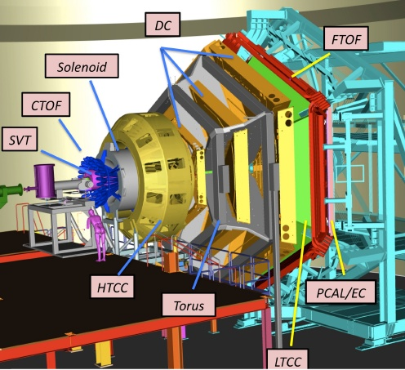
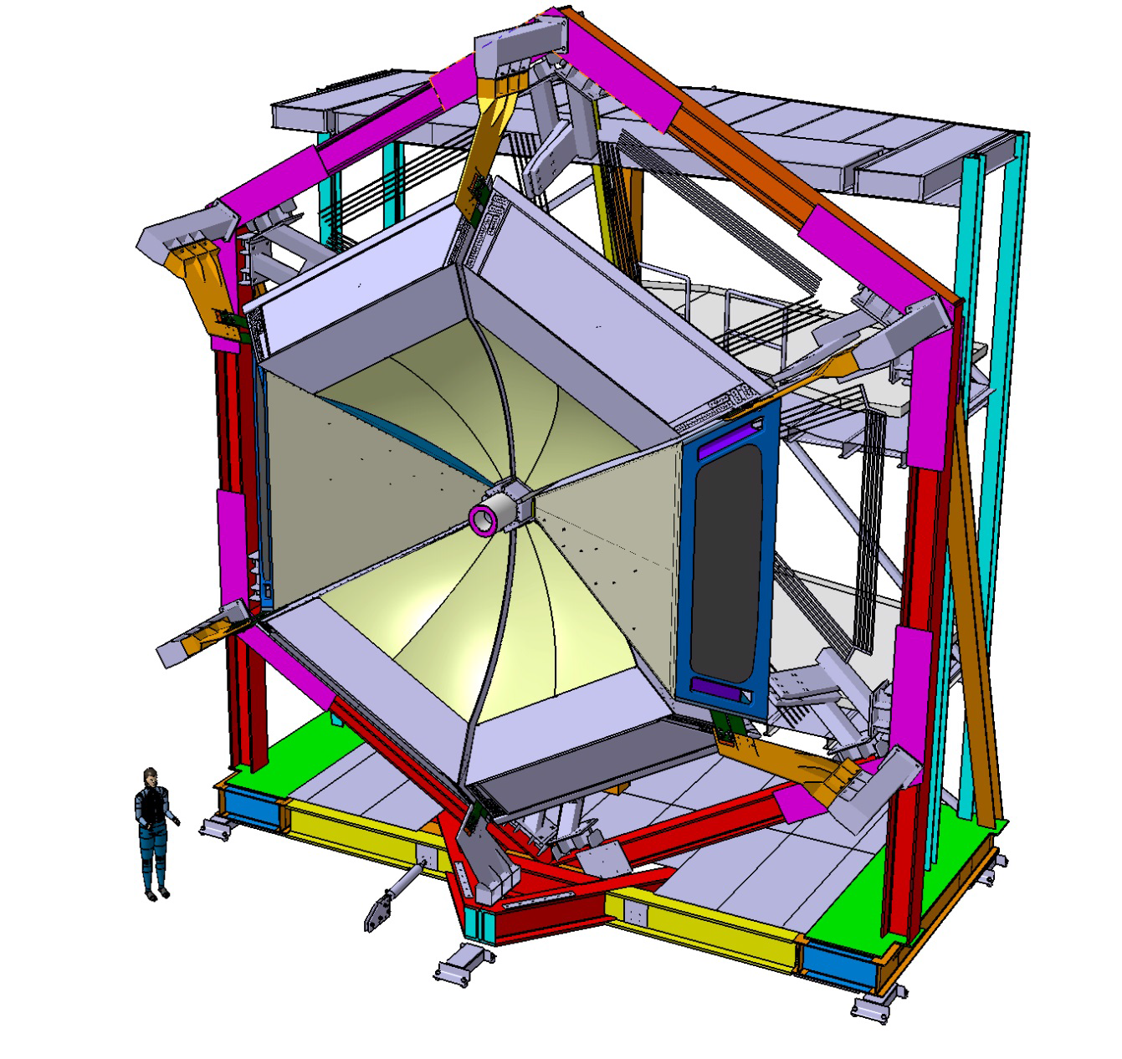
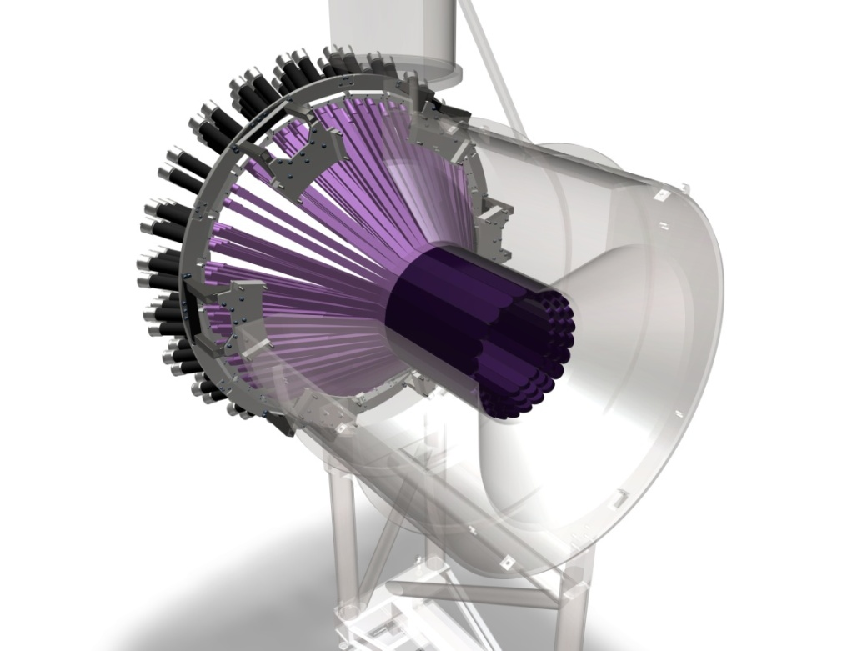
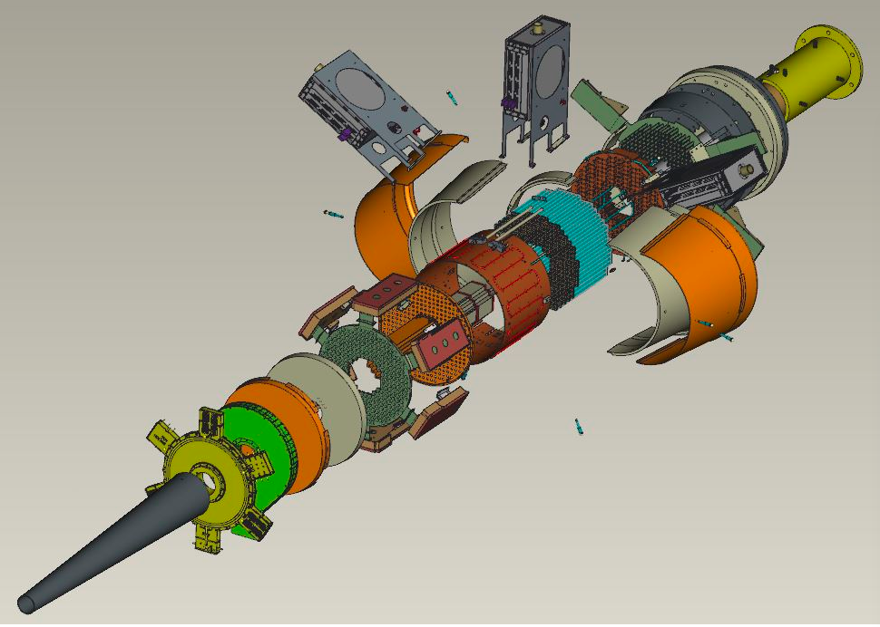
Experimental setup of Run-group M
CLAS12
CLAS12 polarized target
RICH
CND
Forward tagger

Slide 9
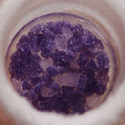
The CLAS12 longitudinally polarized target
Irradiated deuterated ammonia
(ND₃)
UVA, ODU, CNU and JLab
L=4 cm; r = 1.25 cm
P ~ 40%
L ~10³⁴ cm²s⁻¹ /nA
CLAS12
Solenoid (5T)
Pumping system
1K Refrigerator
NMR
Microwaves (140 GHz @ 5T)
Polarizing
Magnet
NMR line shape of ND₃
ND₃ polarization improves with “cold dose”
Notes:
The target is a collaborative effort between the Target group at Jlab, Don Crabb’s Group at Uva, ODU and CNU.
In addition to the target sample, which will be ammonia or deuterated ammonia, you need a high field magnet and low temperature refrigerator. For high luminosity experiments, the combination of 5 T and 1 K seems to work quite well. There has to be large set of vacuum pumps associated with the fridge, a microwave source to drive dynamic polarization, and an NMR system to measure the polarization of the target.
It was observed that by putting a « cold dose » of high-intensity electrons on the ND3 sample, polarizations above 40% could be reached. We plan to do the same for this experiment, so we assumed 40% of average polarization in our estimates for the proposal.

Slide 11

Central Neutron Detector (CND)
Main physics goal: detect the recoiling neutron in nDVCS
Requirements/performances:
good neutron/photon separation for 0.2<p_{n}<1 GeV/c → ~150 ps time resolution
momentum resolution δp/p < 10%
neutron detection efficiency ~10%
Project status:
Construction completed
Detector shipped to JLab in June 2015
Cosmic data analysis:
σ_{t} ~150 ps for all blocks, confirmed with tests at JLab
Readyness Review successfully passed in June
→CND included in CLAS12 baseline equipment
CND design: scintillator barrel - 3 radial layers, 48 bars per layer coupled two-by-two downstream by a “u-turn” lightguide, 144 long light guides with PMTs upstream

Slide 12
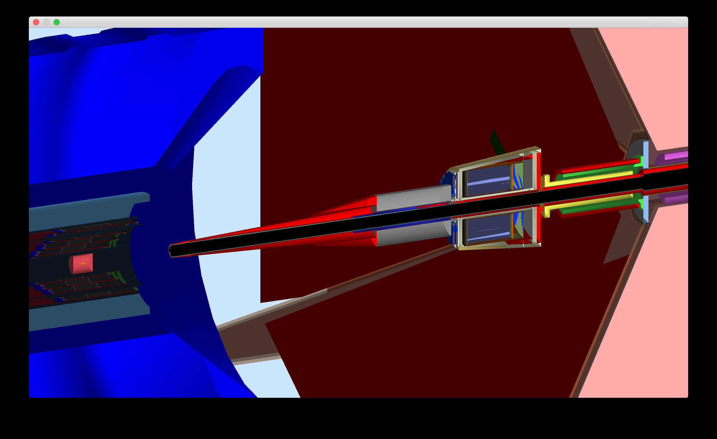
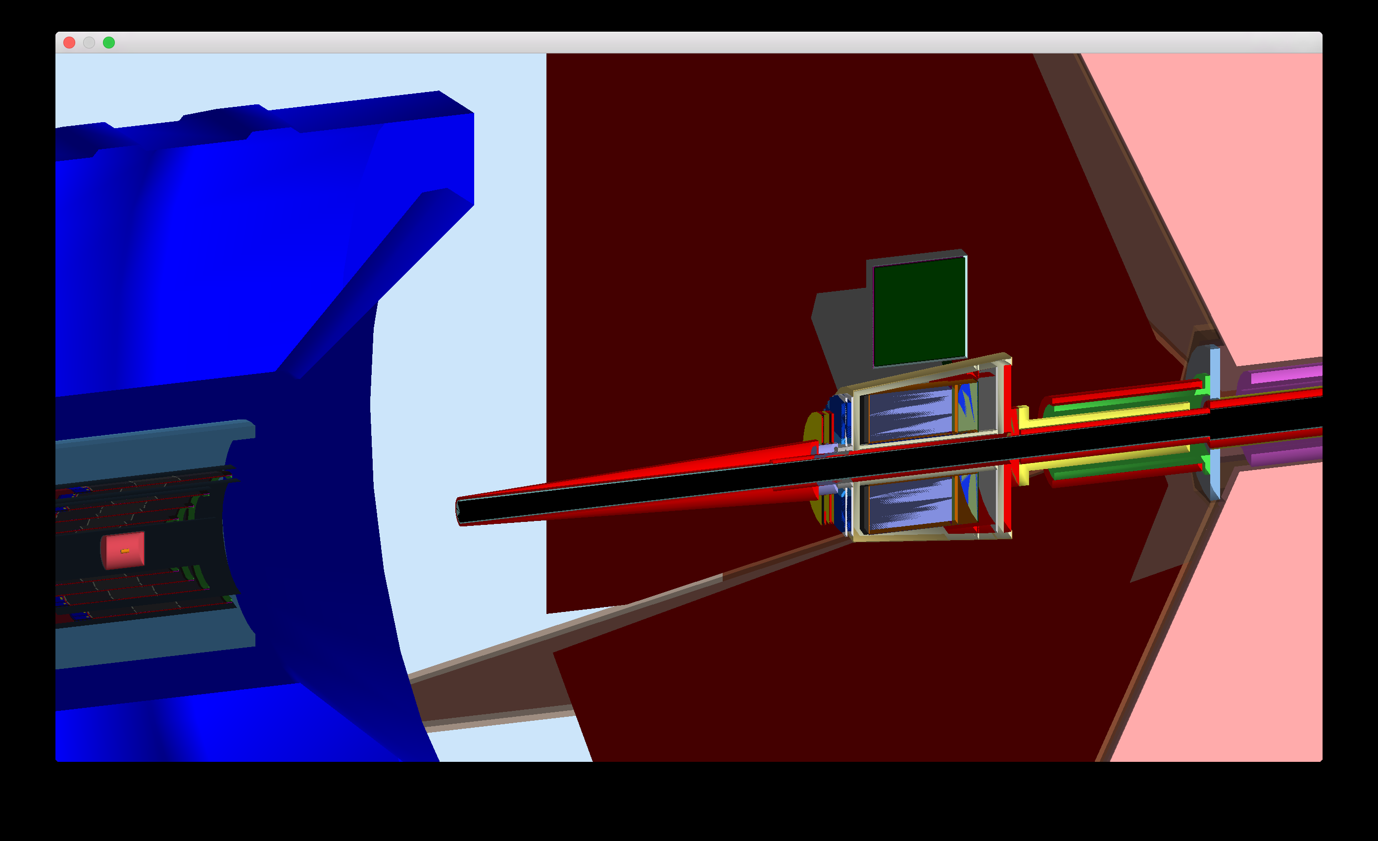
Forward tagger
FT (calorimeter + hodoscope + tracker): polar angles between 2.5° and 4°
→ Important for DVCS, low-angle photons, region where BH dominates, φ ~ 0°-360°
GEMC simulations on ND₃ target, rastered beam, including background
With the current design of the shielding, high occupancy (5%) in DC-R1 at 10 nA
→ FT on for only a subset of the experiment (10 days), with lower current (5 nA)
FT OFF
FT ON
Configuration change (from Bob Miller): 3 PAC days
1 (calendar) day to move the SVT/solenoid/HTCC upstream
1 day to remove the Moller shielding
1 day to install the lead shield, Moller shield, outer shielding cone, and nose cone
1 day to move back the SVT/solenoid/HTCC into position
2 days to reinstall the polarized target and recover the polarization

Slide 13
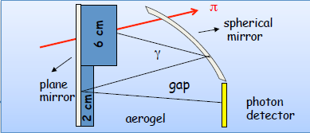
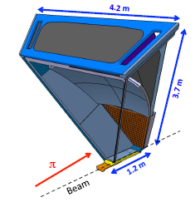
CLAS12 RICH
Design goals:
π/K/p identification from 3 up to 8 GeV/c and 25°
~4σ pion-kaon separation
pion rejection factor ~ 1:500
will cover 2 sectors of CLAS12, replacing LTCC
Project overview:
2010: Concept of Design and Technology
2011: Tests of components and small prototype
2012: Tests of large scale prototype
2013: June: RICH Technical Review
September: Project Review with DOE Start Construction Phase
2014: June: RICH Mechanical Review
2015: June: RICH Internal Review
October: Project Mid--‐term Review DOE
2016: June: RICH Readiness Review
2017: September: Ready for Installation

Slide 14
Deeply-virtual Compton scattering on the neutron with a longitudinally polarized deuteron target
A. Biselli (Fairfield U), C. Keith (JLab), S. Niccolai (IPN Orsay), S. Pisano (INFN Frascati), D. Sokhan (Glasgow U)

Slide 15
Deeply Virtual Compton Scattering and GPDs
e’
e
t
γ
γ*
(Q²)
factorization
x+ξ
x-ξ
~
~
H, H, E, E (x,ξ,t)
N(p)
N(p’)
Polarized beam, unpolarized target:
~
Im{H_{p}, H_{p}, E_{p}}
Proton
Neutron
~
~
~
Δσ_{LU} ~ sinφ Im{F₁H + ξ(F₁+F₂)H -kF₂E}
Im{H_{n}, H_{n}, E_{n}}
Unpolarized beam, longitudinal target:
~
~
Im{H_{p}, H_{p}}
~
Δσ_{UL} ~ sinφIm{F₁H+ξ(F₁+F₂)(H + x_{B}/2E) –ξkF₂ E+…}
Im{H_{n}, E_{n}}
~
Polarized beam, longitudinal target:
Re{H_{p}, H_{p}}
~
Δσ_{LL} ~ (A+Bcosφ)Re{F₁H+ξ(F₁+F₂)(H + x_{B}/2E)…}
Re{H_{n}, E_{n}}
Unpolarized beam, transverse target:
Im{H_{p}, E_{p}}
Δσ_{UT} ~ cosφsin(φ_{s}−φ)Im{k(F₂H – F₁E) +… }
ξ= x_{B}/(2-x_{B})
k=-t/4M²
Im{H_{n}}

Slide 16
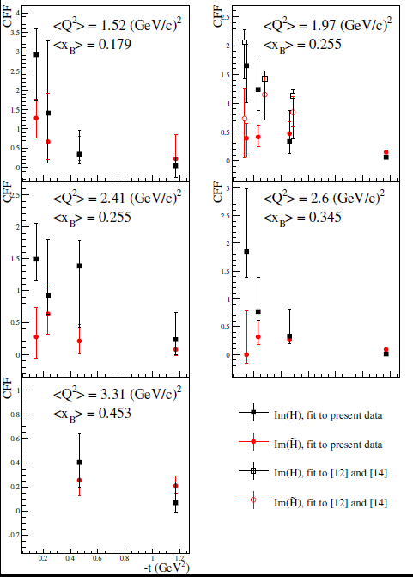
What we learned from CLAS pDVCS asymmetries
Extraction of CFFs from combined analysis
of CLAS data (TSA, BSA, DSA – eg1dvcs)
CFFs fitting code by M. Guidal
M. Guidal, Eur. Phys. J. A 37 (2008) 319, etc…
PROTON TOMOGRAPHY:
ImH has steeper t-slope than ImH : axial charge more “concentrated” than the electric charge
ImH, flatter t-slope at high x_{B}: faster quarks (valence) at the core of the nucleon, slower quarks (sea) at its perifery
~
S. Pisano et al., PRD91 (2015)
z
[12] CLAS BSA (Girod et al.)
[14] CLAS TSA (Chen et al.)
x
Notes:
The DVCS results taken with the 6-GeV beam at JLab taught us that measuring various DVCS observables at the same kinematic point can allow us to extract GPDs in a basically model-independent way. This was done for instance using the CLAS eg1-dvcs data set, which measured, on the proton, BSA, TSA and DSA, using a GPD fitting method by Michel Guidal. The GPDs H and Htilde were extracted, and their kinematical dependence allowed a first attempt of proton tomography. We learned, from the relative slope of the imaginary parts of H and Htilde, that the axial charge is more concentrated in the center of the proton than the electric charge. And, from the t and xB dependency of ImH we learned that the valence quarks are located at the center of the nucleon and the sea quarks at the perifiery.

Slide 17
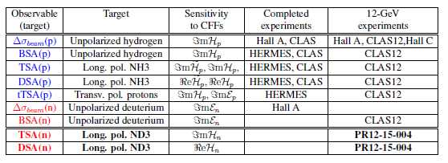
DVCS program
for JLab12
Proton
Neutron
C12-15-004
Notes:
All the spin observables for proton DVCS were measured at JLab@6 GeV and/or HERMES, and will be extracted on wider kinematics and with increased precision at JLab@12 GeV.
From the neutron point of view, pioneering beam-polarized cross sections differences were extracted in Hall A at 6 GeV on limited kinematics, and one experiment is approved for CLAS12 planning to extract beam spin asymmetries. The experiment we propose will fill the gap of the missing neutron DVCS spin observables.

Slide 18
Flavor separation of GPDs
Proton and neutron GPDs (and CFFs) are linear combinations of quark GPDs
A combined analysis of DVCS observables for proton and neutron targets is necessary to perform the flavor separation of the GPDs
Measurements of DVCS on neutron target are crucial for the completion
of a comprehensive GPD program for JLab@12 GeV
We propose to extend the JLab experimental program for
nDVCS, started with the beam-spin asymmetry (E12-11-003), by measuring for the first time target-spin single and double asymmetries
We will use the 50 days of beam on longitudinally polarized ND3 of Run Group Cb
This new run group proposal plans to extend this beam time to 110 days

Slide 19
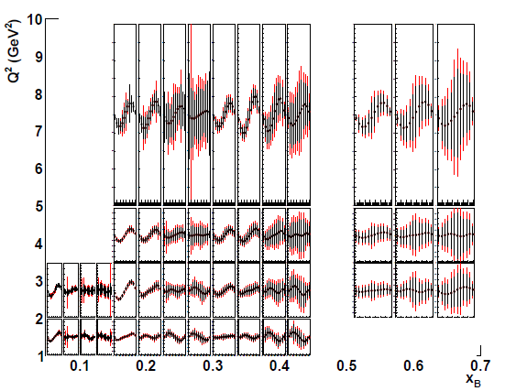
Projected results: target-spin asymmetry
L = 3/20∙10³⁵cm⁻²s⁻¹, Time = 100 days@10 nA + 10 days@5 nA with Forward tagger, P_{t} = 0.4
Count rates computed with nDVCS+BH
event generator
+ CLAS12 acceptance from FastMC
+ CND efficiency from GEANT4 simulation
Asymmetries computed with VGG model
TSA ~ 0.2
1
0
First time measurement
• 4 bins in Q²
• 4 bins in −t
• 4 bins in x_{B}
• 12 bins in φ
(Same as E12-11-003)
-1
Red points = 50 days

Slide 20
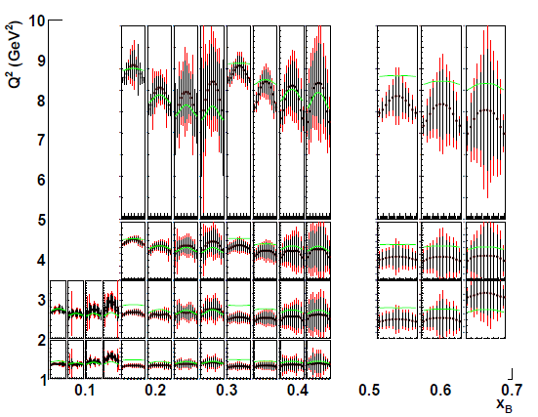
Projected results: double spin asymmetry
L = 3/20∙10³⁵cm⁻²s⁻¹, Time = 100 days@10 nA + 10 days@5 nA with Forward tagger, P_{t} = 0.4, P_{b} = 0.85
Count rates computed with nDVCS+BH
event generator
+ CLAS12 acceptance from FastMC
+ CND efficiency from GEANT4 simulation
Asymmetries computed with VGG model
DSA up to 0.8
1.2
0
First time measurement
• 4 bins in Q²
• 4 bins in −t
• 4 bins in x_{B}
• 12 bins in φ
(Same as E12-11-003)
-0.6
Red points = 50 days
Green curves: BH

Slide 21
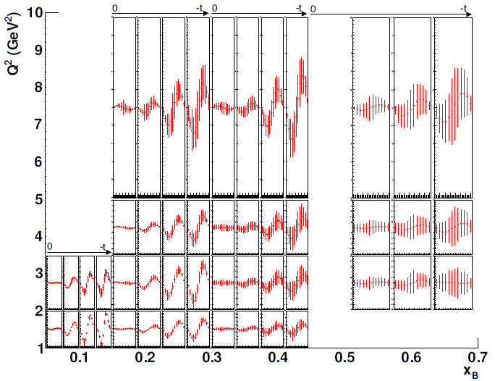
Projected beam spin asymmetry from C12-11-003
L = 10³⁵cm⁻²s⁻¹ for LD, Time = 80 days; P_{b} = 0.85
Count rates computed with nDVCS+BH
event generator
+ CLAS12 + FT acceptance from FastMC
+ CND efficiency from GEANT4 simulation
Asymmetries computed with VGG model
BSA ~ 0.05
0.25
0
• 4 bins in Q²
• 4 bins in −t
• 4 bins in x_{B}
• 12 bins in φ
-0.25
High-impact experiment

Slide 22
Combined analysis of C12-15-004 and E12-11-003
110 days
50 days
ImH_{n}
Extraction of neutron CFFs using M. Guidal’s fitting code. Fit of TSA, DSA (PR12-15-004) and BSA
(E12-11-003)
7 CFFs as free fit parameters
ImE = 0
~

Slide 23
Combined analysis of C12-15-004 and E12-11-003
110 days
50 days
ImE_{n}

Slide 24
Combined analysis of C12-15-004 and E12-11-003
ReH_{n}
110 days
50 days
~
ImH_{n}

Slide 25
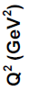
Combined analysis of C12-15-004 and E12-11-003
~
110 days
50 days
ReH_{n}
~
ReE_{n}
ReE_{n}

Slide 26
Projections for flavor separation (ImH)
Fit using all the projected pDVCS asymmetries of the CLAS12 program
Fit using the projected nDVCS asymmetries of
C12-15-004 and
E12-11-003
(110 days)
Fit using the projected nDVCS asymmetries of
PR12-06-109a and
E12-11-003
(50 days)

Slide 27
Projections for flavor separation (ImE)
Fit using all the projected pDVCS asymmetries of the CLAS12 program
Fit using the projected nDVCS asymmetries of
C12-15-004 and
E12-11-003
(110 days)
Fit using the projected nDVCS asymmetries of
PR12-06-109a and
E12-11-003
(50 days)

Slide 28
Deep Inclusive Scattering (DIS) on
Deuterium: The case for doubling the statistics
Sebastian Kuhn, ODU, contact person

Slide 29
Present Status: What do we know about polarized PDFs?
JAM
Fit
JLab data impact
Higher Twist
d poorly known at high x

Slide 30
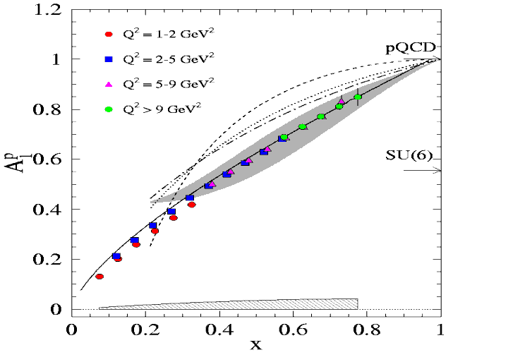
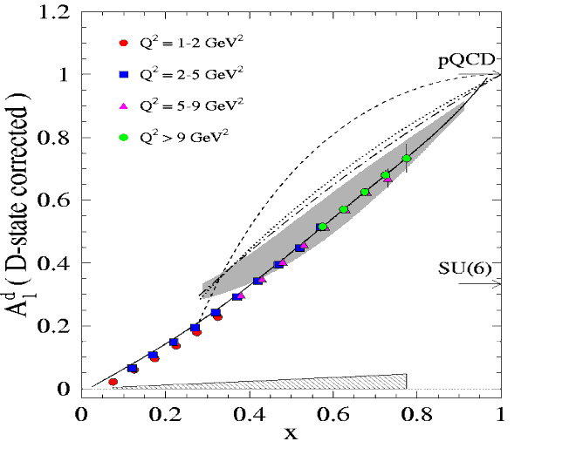
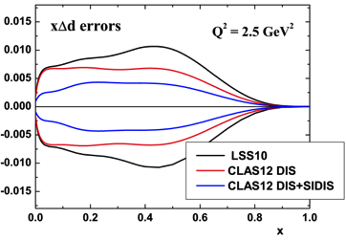
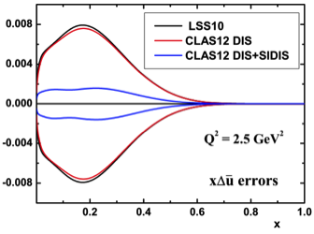
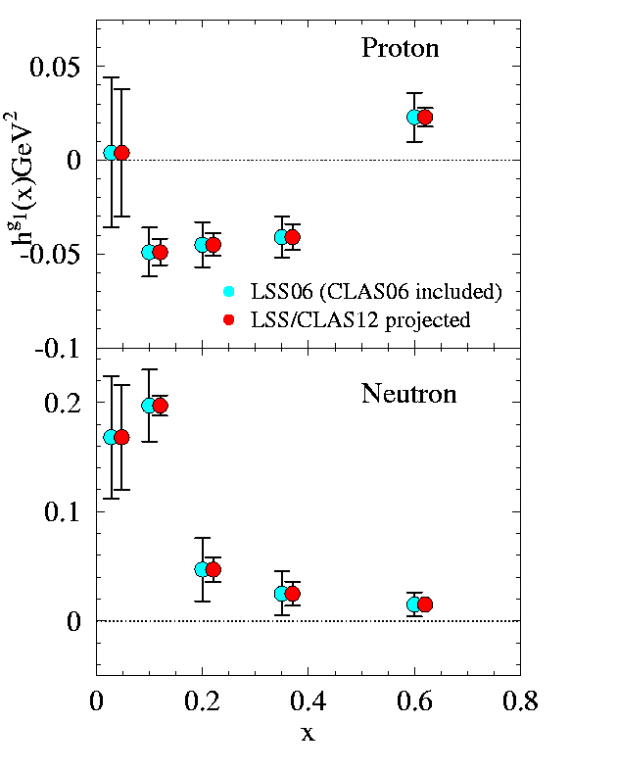
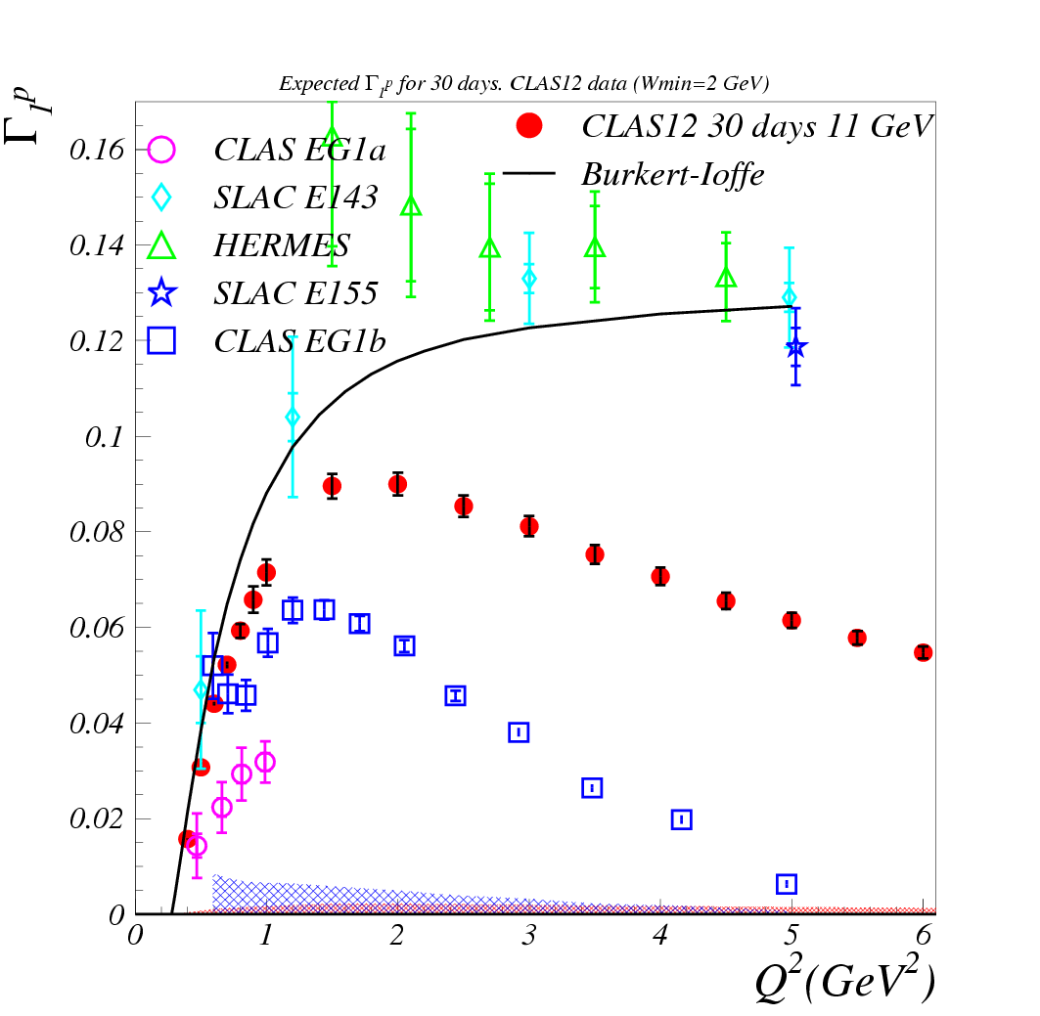
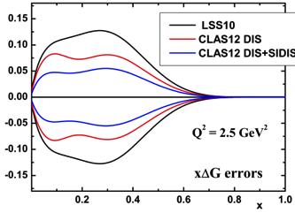
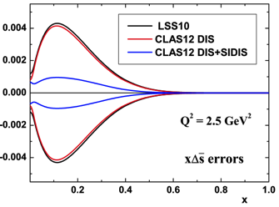
CLAS12 Approved (RG C: 30 days p, 50 days d)
Goal of E12-06-109: x-dependence of each PDF (q or g) for 0.06< x 0/8
Additional information on Δq from SIDIS
p
d
SIDIS A₁
Inclusive A₁
h⁺
h⁻
Greater
x-coverage
for Γ₁
Better determination of Higher Twist vs. x
Improved coverage to
evaluate moments
Improved PDFs from NLO analyses

Slide 31
What will 50 more days on D get us?
Relative uncertainties on polarized PDFs with various data sets (Courtesy N. Sato)
Notes:
Includes both statistics and estimated systematic uncertainties

Slide 32
What will 50 more days on D get us?
Crucial!
Relative uncertainties on polarized PDFs with various data sets (Courtesy N. Sato)
Notes:
Includes both statistics and estimated systematic uncertainties

Slide 33
What will 50 more days on D get us?
Δd/d for x→1
Curves: pQCD without and with OAM effects (Brodsky et al. Nucl. Phys. B441 (1995) – Avakian et al. PRL99 (2007))
Projections: hyperfine perturbed model (N. Isgur et al., PRD59 (1999)
As approved
With doubled beam time
With “unlucky” statistical fluctuations, cannot exclude Δd/d > 0 at highest x (χ²/dof=2.5, p=8%)
Even with “unlucky” statistical fluctuations, can exclude Δd/d > 0 at highest x (χ²/dof=6.6, p=0.4%)

Slide 34
What will 50 more days on D get us?
A₁ from SIDIS (kaon channels) – HERMES data
Only K⁻ production on D is uniquely sensitive to Δs (Δu and Δd largely cancel)
Δs→0
Notes:
Note: Existing data are of course pitiful; this is just to illustrate how HIGH statistics data on the d can have a very big impact.

Slide 35
Semi-Inclusive Deep Inelastic Scattering (SIDIS) on deuterium: The case for doubling the statistics
Silvia Pisano, INFN Frascati, contact person

Slide 36
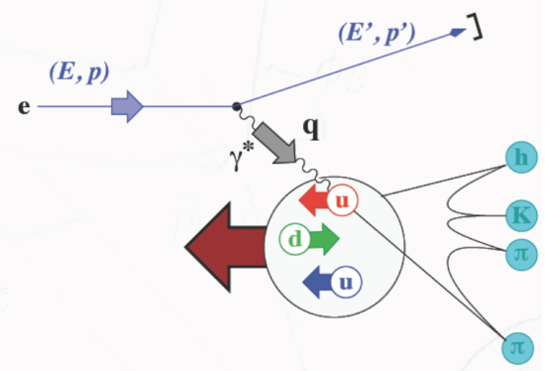
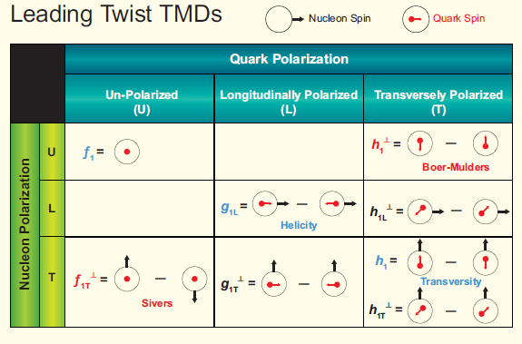
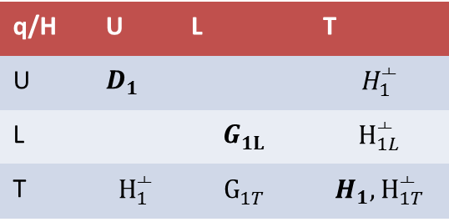
Transverse Momentum Dependent PDFs&FFs
8 leading-twist TMDs
They depend on the parton longitudinal momentum fraction x
and on its transverse momentum k_{T}
→ 3D dynamics of the nucleon
Fragmentation Functions
→ transition from partonic to hadronic degrees of freedom
q/H | U | L | T
U
L
T
Kotzinian-Mulders

Slide 37
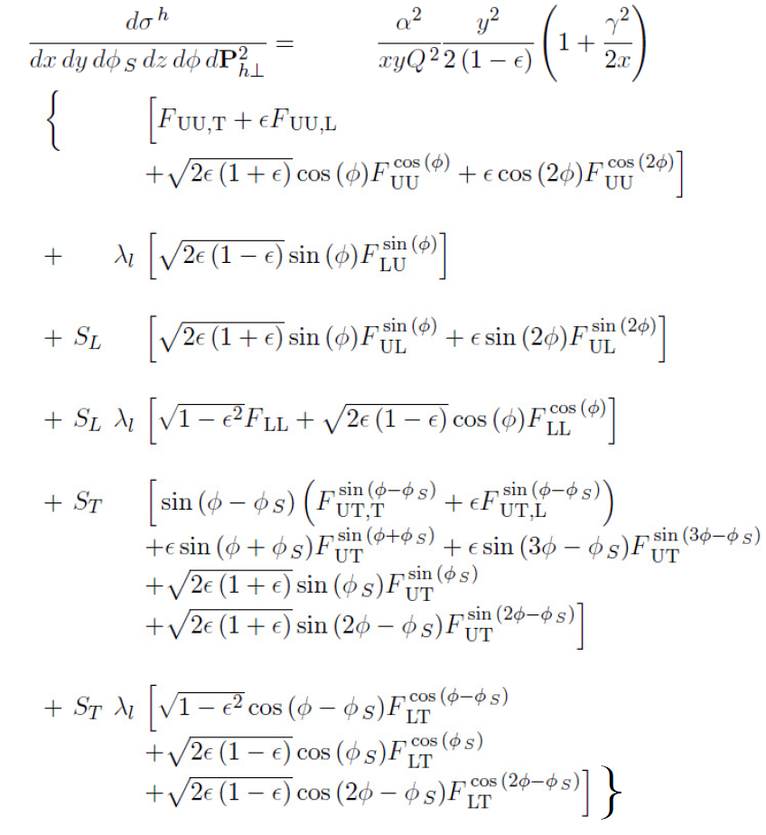
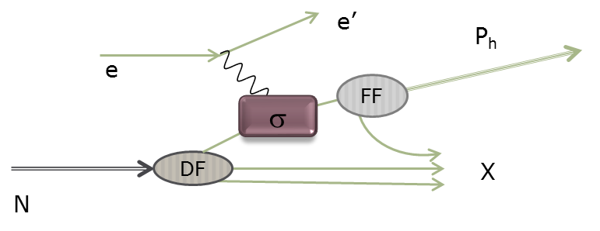
Single-hadron SIDIS cross-section
Depending on the polarizations of beam and target, different TMD and FF can be accessed:
q
Unpolarized target
(P₁)
18 structure functions appear in the cross section
Longitudinally pol. target
Tranversely pol. target
D₁: unpolarized FF
H₁┴: polarized FF

Slide 38
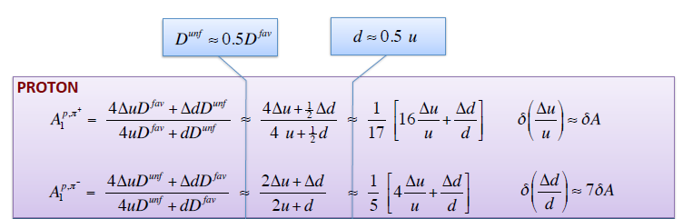
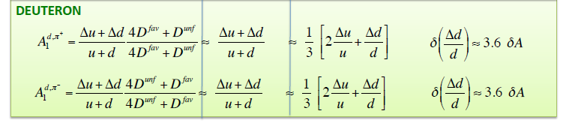
SIDIS and flavor separation of PDFs
f.o.m = dil. factor*polarization, roughly the same for NH₃ and ND₃;
assuming the same statistics for proton and deuteron data
Thanks to M. Contalbrigo

Slide 39
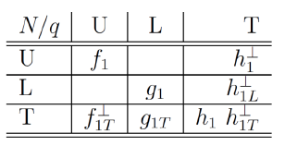
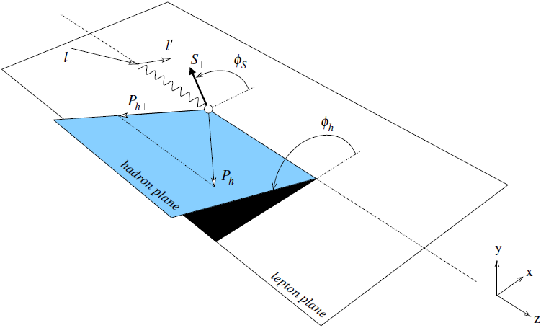
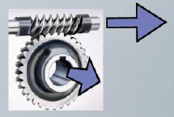
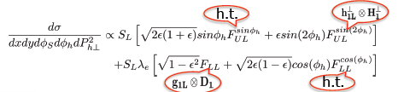
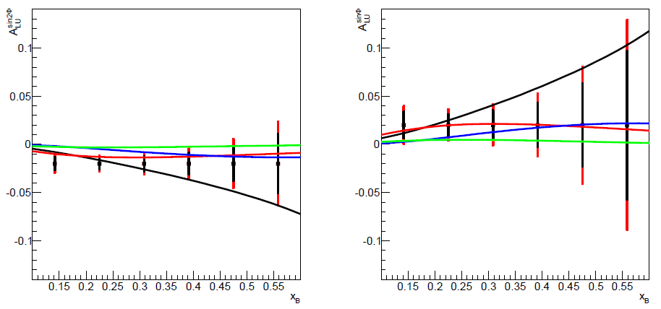
SIDIS on polarized ND₃: single target spin asymmetry
A_{UL}: Kotzinian-Mulders→transversely polarized quark in a longitudinally polarized proton
K⁺
K⁻
Doubling the statistics helps at high x_{B}, where models differ the most, and it is crucial for the K⁻ channel, which has lower statistics
50 days
100 days
Pasquini et al., PRD78 (2008)
CQM, for different wave functions

Slide 40


SIDIS on polarized ND₃: double spin asymmetry
50 days
Anselmino et al., PRD74 (2006)
Different k_{T} widths for helicity distributions
p_{T} dependence of A_{LL}: access to the helicity dependence of k_{T} distributions of quarks
p & d data for p_{T}-dependent flavor decomposition
Doubling the statistics helps at high p_{T}, where models differ the most, and it is crucial for the K⁻ channel, which has lower statistics
100 days

Slide 41
SIDIS on polarized ND₃: double spin asymmetry
50 days
Higher-twist TMDs
N/q | U | L | T
U | f┴ | g┴ | h,e
L | f_{L}┴ | g_{L}┴ | h_{L},e_{L}
T | f_{T}, f_{T}┴ | g_{T}, g_{T}┴ | h_{T},e_{T},h_{T}┴ ,e_{T}┴
Anselmino et al., PRD74 (2006)
Different k_{T} widths for helicity distributions
100 days
Also for pions, doubling the statistics helps at high p_{T}, where models differ the most

Slide 42


Additional topics
First time measurement of Timelike Compton scattering, γn→ne⁺e⁻, on longitudinally polarized neutron:
universality of GPDs
A_{UL} and A_{LL} have sensitivity to H_{n} and E_{n}
A_{UL} expected to be fairly big (0.15)
nTCS cross section only a factor of 2 less than the pTCS one
120 days approved for pTCS with unpolarized target
First-time measurement of di-hadron SIDIS on longitudinally polarized deuterium:
cleanest access to chiral-odd PDFs
promising preliminary results for A_{UL} on NH3@CLAS
ND₃ needed for flavor dependence of the various PDFs and FFs, high stat for mapping
DVMP on longitudinally polarized neutrons:
transversity neutron-GPDs in pseudoscalar channels (π⁰, η, π⁻)
link to transversity GPDs shown with 6-GeV results on
A_{UL} proportional to LT interference term of the cross section→H_{T}, E_{T}, E_{T}

Slide 43
Conclusions/summary: CLAS12 Run group M
The multi-dimensional mapping of the nucleon is one of the primary goals of the 12-GeV upgrade of JLab, and is at the core of the CLAS12 program
Parton distributions depend on quark flavors, measurements on proton and deuterium are necessary
Current approved beam time on ND₃ for CLAS12 is ~40% of the NH₃ one
We request 73 PAC days of new beam time:
60 of production running on ND₃, 13 of ancillary measurements/configuration change
11 GeV beam, polarization 85%
Setup: CLAS12 + ND₃ polarized target, CND, RICH, FT (for 10 days at 5 nA)
This will bring the total running time on ND₃ for CLAS12 at 133 days – same as NH₃
First time measurement of polarized nDVCS
High precision DIS, SIDIS
Exploratory measurements of DVMP, nTCS, di-hadron SIDIS

Slide 44


CND: expected performances (Monte Carlo)
GEANT4 simulations used to evaluate:
efficiency
PID (neutron/photon separation)
momentum and angular resolutions
definition of reconstruction algorithms
background studies
Measured σ_{t} and light loss due to u-turn implemented in the simulation
Efficiency ~ 8-9%
for a threshold of 3 MeV, TOF<8 ns
and p_{n} = 0.2 - 1 GeV/c
PMT-N
PMT-D

Slide 45



nDVCS@CLAS12: kinematics and acceptances
ed→e’nγ(p)
nDVCS+BH event generator on a FREE deuteron target
+ CLAS12 acceptance from FastMC (eγ)
+ CND efficiency from GEANT4 simulation
80% of neutrons in CND (θ>40°)
E_{e} = 11 GeV, Q²>1 GeV², W>2 GeV², t<-1.2 GeV²
nDVCS-BH photons have E>2 GeV

Slide 46

Definitions of nDVCS observables
For each 4-D. bin in (Q², x_{B}, -t, φ)
Target-spin
asymmetry
Im{H_{n}, E_{n}}
Double spin
asymmetry
Re{H_{n}, E_{n}}
MM²(ed→enγX)
p(x)(ed→enγX)
MM²(en→enγX)
Yields extracted applying exclusivity cuts to enγX events
E(x)(ed→enγX)
p_{perp} (en→enγX)
Exclusivity cuts suppress:
nuclear background (¹⁴N)
π⁰ background
accidentals in the CND
Dilution factor
(needs ¹²C data)

Slide 47


Definitions of nDVCS observables
For each 4-D. bin in (Q², x_{B}, -t, φ)
Target-spin
asymmetry
Im{H_{n}, E_{n}}
Double spin
asymmetry
Re{H_{n}, E_{n}}
b: beam; t: target
FC^{bt}: charge, (Faraday Cup)
B_{π0}: π⁰ contamination
P_{t}: target pol.; P_{b}: beam pol.
D_{f}: dilution factor
Charge-normalized DVCS/BH yield
Projected π⁰ contamination vs φ
π⁰ contamination in the eg1-dvcs pDVCS analysis
TSA (eg1dvcs) before and after π⁰ subtraction
~11% effect on TSA
~6% on DSA

Slide 48

Deeply Virtual Compton Scattering and GPDs
e’
Q²= - (e-e’)²
x_{B} = Q²/2Mν ν=E_{e}-E_{e’}
x+ξ, x-ξ longitudinal momentum fractions
t = Δ² = (p-p’)²
x ≅ x_{B}/(2-x_{B})
e
t
γ
γ*
(Q²)
factorization
x+ξ
x-ξ
~
~
« Handbag » factorization valid
in the Bjorken regime:
high Q² , ν (fixed x_{B}), t<<Q²
H, H, E, E (x,ξ,t)
N(p)
N(p’)
At LO QCD, twist 2, chiral-even, quark sector → 4 GPDs for each quark flavor
~
conserve nucleon spin
Vector: H (x,ξ,t)
Tensor: E (x,ξ,t)
Axial-Vector: H (x,ξ,t)
Pseudoscalar: E (x,ξ,t)
~
flip nucleon spin
Nucleon tomography
M. Burkardt, PRD 62, 71503 (2000)
Notes:
The proposed experiment is part of the category 3D structure of the hadron, via the study of generalized parton distributions.
The channel more directly interpretable in the terms of GPDs is DVCS, which is the electroproduction of a real photon on a quark of the nucleon. You see it here represented by the « handbag » diagram, which shows the virtual photon that interacts with one of the quarks of the nucleon, which propagates and then radiates a real photon, before « going back » in the nucleon. The handbag implies the factorization of this reaction in two parts: the top one, describing the virtual-photon/quark interaction, which is calculable in perturbative QCD; and the bottom one, describing the partonic structure of the nucleon, which is encoded in the generalized parton distributions. The handbag factorization holds in the so-called Bjorken regime, which requires to be at high Q2 with respect to the momentum transfered to the proton (t).
At leading order and twist in QCD, considering only quark-helicity conserving quantities and the quark sector, there are 4 GPDs, H, Htidle, E, Etilde, and they depend on three variables: x, the momentum fraction carried by the struck quark, csi, the difference of the quark momentum between initial and final state (which is linked to the Bjorken variable xB) and t, the momentum transfered to the nucleon. There are 4 GPDs to describe different combinations of nucleon spin with respect to the quark’s helicity, for the initial and final states.
The GPDs can provide us a tomography of the nucleon, providing information about the transverse position of partons having a given longitudinal momentum.

Slide 49
Deeply Virtual Compton Scattering and GPDs
e’
Q²= - (e-e’)²
x_{B} = Q²/2Mν ν=E_{e}-E_{e’}
x+ξ, x-ξ longitudinal momentum fractions
t = Δ² = (p-p’)²
x ≅ x_{B}/(2-x_{B})
e
t
γ
γ*
(Q²)
factorization
x+ξ
x-ξ
~
~
« Handbag » factorization valid
in the Bjorken regime:
high Q² , ν (fixed x_{B}), t<<Q²
H, H, E, E (x,ξ,t)
N(p)
N(p’)
At LO QCD, twist 2, chiral-even, quark sector → 4 GPDs for each quark flavor
~
conserve nucleon spin
Vector: H (x,ξ,t)
Tensor: E (x,ξ,t)
Axial-Vector: H (x,ξ,t)
Pseudoscalar: E (x,ξ,t)
~
flip nucleon spin
Nucleon tomography
Quark angular momentum (Ji’s sum rule)
X. Ji, Phy.Rev.Lett.78,610(1997)
M. Burkardt, PRD 62, 71503 (2000)
Notes:
Among the information that GPDs can bring, a very important one is that they can allow us to compute the quark angular momentum, which is given by, according to Ji’s sum rule, the second moment in x of the sum of the GPDs H and E calculated at t=0.

Slide 50

Accessing GPDs through DVCS
DVCS allows access to 4 complex GPDs-related quantities: Compton Form Factors (ξ,t)
Only ξ and t are accessible
experimentally
BH is calculable
(electromagnetic FFs)
γ
φ
e’
e
leptonic plane
N’
hadronic
plane
Notes:
The DVCS amplitude is proportional to a linear combination of 4 complex GPD-related quantities, which are called Compton Form Factors. The real part of the CFF is an integral over x of a GPD, while the imaginary one is the GPD computed at the x=+-csi points. So, measuring DVCS allow us to only obtain the csi and t dependence of GPDs, while x is integrated over.
The DVCS final state is the same as the BH one. BH is well known and calculable from the electromagnetic FF.
If we measure cross sections or DSA we are sensitive to the real part of the CFFs. If we measure single-spin asymmetries we are sensitive to the DVCS/BH interference, which is linked to the imaginary part of the CFFs.
By looking at the phi dependence of the epg observables, the various terms of the epg amplitude can be singled out.

Slide 51
Sensitivity to CFFs of DVCS spin observables
Twist 2
approximation
(-t<<Q²)
(ξ= x_{B}/(2-x_{B}) k=-t/4M²)
Proton Neutron
Polarized beam, unpolarized target:
~
Im{H_{p}, H_{p}, E_{p}}
~
s^{I}_{1,unp} ~ sinφ Im{F₁H + ξ(F₁+F₂)H -kF₂E}
~
Im{H_{n}, H_{n}, E_{n}}
Unpolarized beam, longitudinal target:
~
~
~
Im{H_{p}, H_{p}}
s^{I}_{1,UL} ~ sinφIm{F₁H+ξ(F₁+F₂)(H + x_{B}/2E) –ξkF₂ E+…}
Im{H_{n}, E_{n}}
~
Polarized beam, longitudinal target:
Re{H_{p}, H_{p}}
~
c^{I}₁,_{LP} ~ (A+Bcosφ)Re{F₁H+ξ(F₁+F₂)(H + x_{B}/2E)…}
Re{H_{n}, E_{n}}
Unpolarized beam, transverse target:
Im{H_{p}, E_{p}}
Δσ_{UT} ~ cosφsin(φ_{s}−φ)Im{k(F₂H – F₁E) +… }
Im{H_{n}}
Notes:
At leading twist, the sinfi term of the single-spin asymmetries and the cosphi/numerator term of the DSA are proportional to the interference of DVCS and BH, and are linear combinations of CFFs and electromagnetic form factors. The coefficients of the combinations change for each observable, making each observable sensitive to a specific combination of CFFs.
nDVCS complements pDVCS for the different sensitivity to GPDs of the various observables.

Slide 52



Multi-dimensional mapping of the nucleon
Wigner «mother» functions are quantum-phase distributions of quarks
→ not directly accessible, we can only extract their reductions
Picture by A. Bacchetta
e’
e
t
γ
γ*
(Q²)
x+ξ
x-ξ
N(p)
N(p’)
e
e’
e
e’
γ∗ (Q²)
γ∗ (t=Q²)
x
X
p
p’
p

Slide 53

CLAS12 Approved (RG C: 30 days p, 50 days d)
Goal of E12-06-109: x-dependence of each PDF (q or g) for 0.06< x 0/8
Additional information on Δq from SIDIS
p
d
SIDIS A₁
Inclusive A₁
h⁺
h⁻
Greater
x-coverage
for Γ₁
Better determination of Higher Twist vs. x
Improved coverage to
evaluate moments
Improved PDFs from NLO analyses

